Slide 1
PYTHON POWERED:
CREDIT CARD FRAUD
DETECTION

Slide 2

Idea
Credit card fraud is a significant issue that affects both financial institutions and cardholders.
The Idea of this project is to develop a robust and efficient credit card fraud detection system using machine learning and data analysis techniques using pythonic approaches. To tackle this Problem we need a system that can abort the transaction if it finds fishy.
Our goal is to create a system that can identify fraudulent transactions in real-time, thereby minimizing financial losses and ensuring the security of cardholders' accounts.
As we are moving towards Digitalisation we prefer to make transaction using credit card while purchasing any product online but on the other hand Cyber attackers misuse this technology.

Slide 3
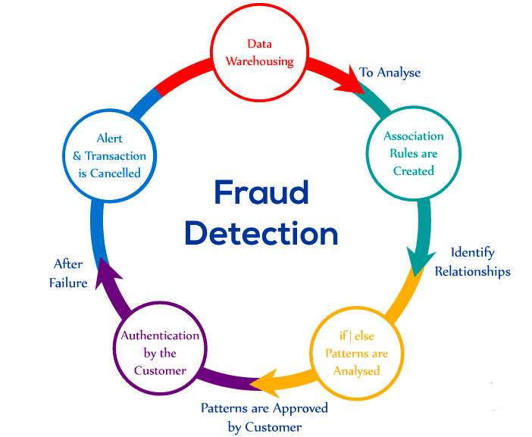
Application Area
PAYMENT PROCESSES : Payment gateway providers and processors employ fraud detection to ensure secure transactions.
MOBILE APP’S : Mobile payment apps and in-app purchases also require fraud detection prevent unauthorised transactions.
E-COMMERCE : Online retailers use fraud detection to prevent fraudulent purchases and protect both customers and their own revenue .
FINANCIAL INSTITUTIONS : Banks and credit card companies use fraud detection systems to protect their customers from unauthorized transaction.
HEALTHCARE : Fraud detection is used to prevent medical identity
theft and insurance fraud
TRAVEL AND HOSPITALITY : The travel industry uses fraud detection
To combat booking fraud , such as unauthorized hotel reservations.
ANY ONLINE TRANSACTION : Virtually any online service or
Business that accepts payments via credit cards can benefit from
Fraud detection to safeguard their customers and revenues .

Slide 4
Team Details and Work Distribution
TEAM MEMBER 1 NAME : PRIYESH SINGH COLLAGE ID : E23CSEU0050
BRANCH : B-TECH CSE. WORK DISTRIBUTION : MAJOR CODING AND PPT DESIGNING
TEAM MEMBER 2 NAME : HARSH VARDHAN CHAUHAN COLLAGE ID : E23CSEU0041
BRANCH : B-TECH CSE. WORK DISTRIBUTION : PPT CREATION AND SUBSET OF CODING
TEAM MEMBER 3 NAME : PARMESH GOYAL COLLAGE ID : E23CSEU0042
BRANCH : B-TECH CSE. WORK DISTRIBUTION : CREATING SUBSETS OF THE CODING AND FINDING DATASET

Slide 5

Thank You

